Slide 1

#pix2pix Image-to-Image Translation with Conditional Adversarial Networks
Presented by
Md Javedul Ferdous
Shahab Uddin
Salih Sarp

Slide 2
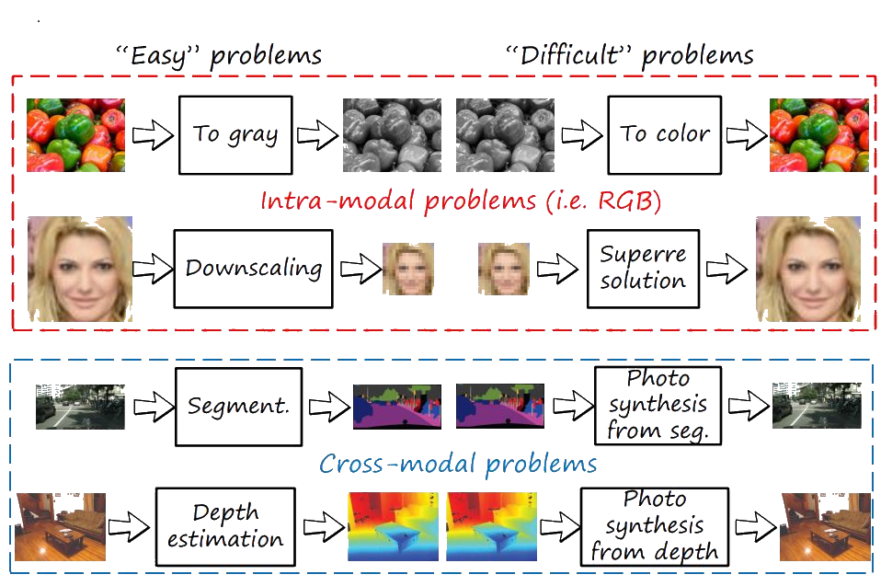

Introduction

Slide 3
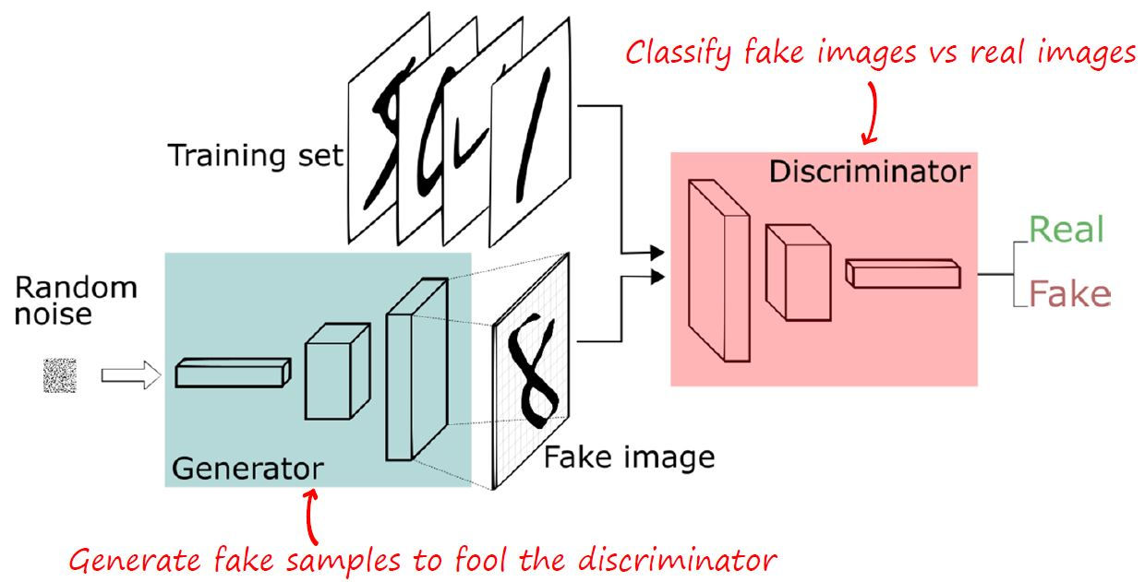
Generative Adversarial Networks
Goodfellow et al., “Generative Adversarial Networks”, NIPS 2014
Figure from https://deeplearning4j.org/generative-adversarial-network

Slide 4
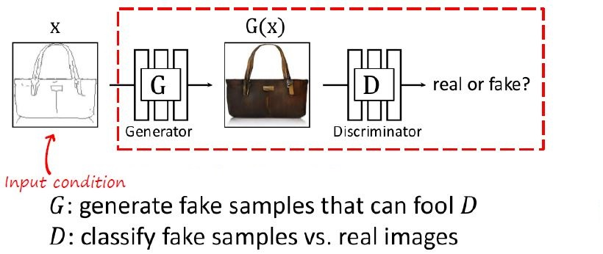
Generative Adversarial Networks
Isola et al., “Image-to-Image Translation with Conditional Adversarial Networks”, CVPR 2017
Slide adapted from Zhu and Isola
Image-to-image translation
Luis Herranz, Joost van de Weijer

Slide 5
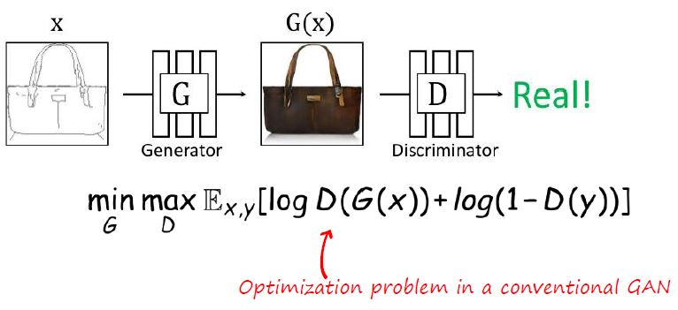
Generative Adversarial Networks
Isola et al., “Image-to-Image Translation with Conditional Adversarial Networks”, CVPR 2017
Slide adapted from Zhu and Isola
Image-to-image translation
Luis Herranz, Joost van de Weijer

Slide 6
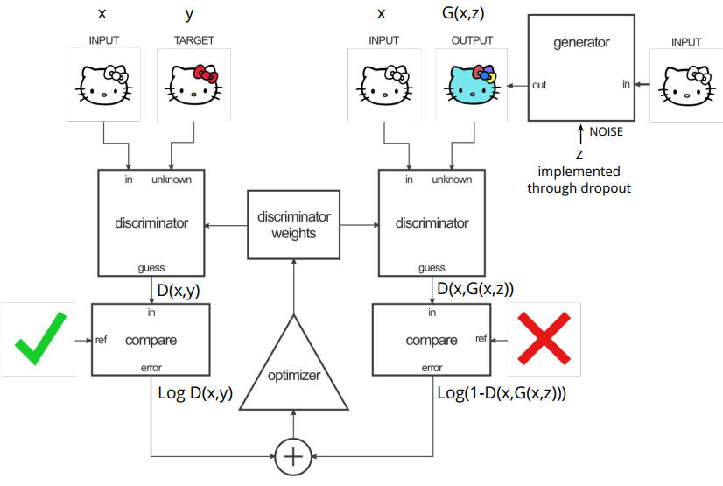
Train Discriminator

Slide 7
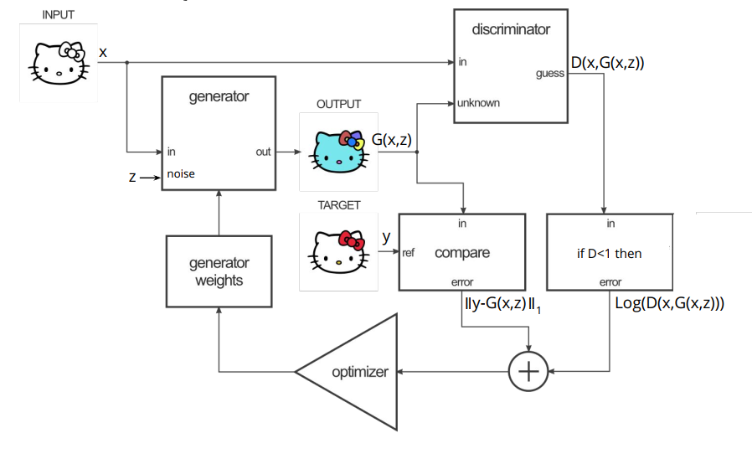
Train Generator

Slide 8

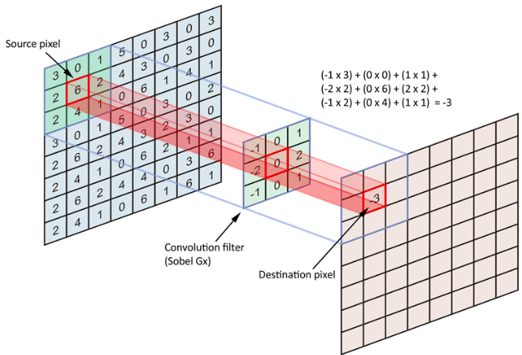
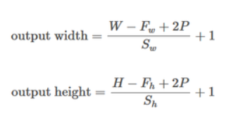
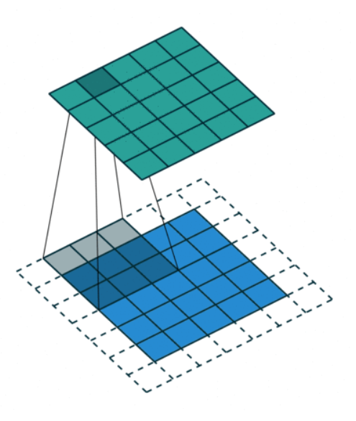
Convolution
W or H=input size
F=filter (kernel) size
P=padding
S=stride

Slide 9
Batch Normalization
Batch normalization is a technique designed to automatically standardize the inputs to a layer in a deep learning neural network.
#The layer will transform inputs so that they are standardized, meaning that they will have a mean of zero and a standard deviation of one.
Benefits:
1. Accelerating the training process of a neural network,
2. and in some cases improves the performance of the model via a modest regularization effect.
Notes:
https://machinelearningmastery.com/how-to-accelerate-learning-of-deep-neural-networks-with-batch-normalization/

Slide 10
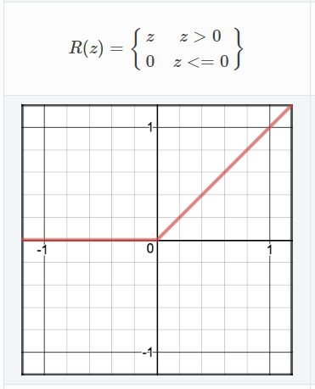
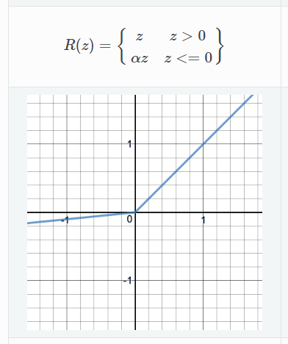
Activation Functions
ReLU
LeakyReLU

Slide 11
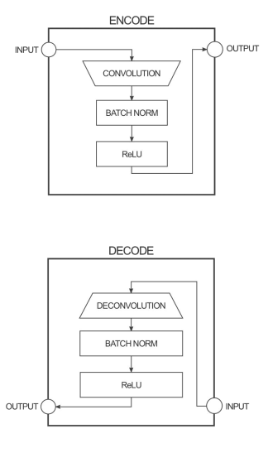
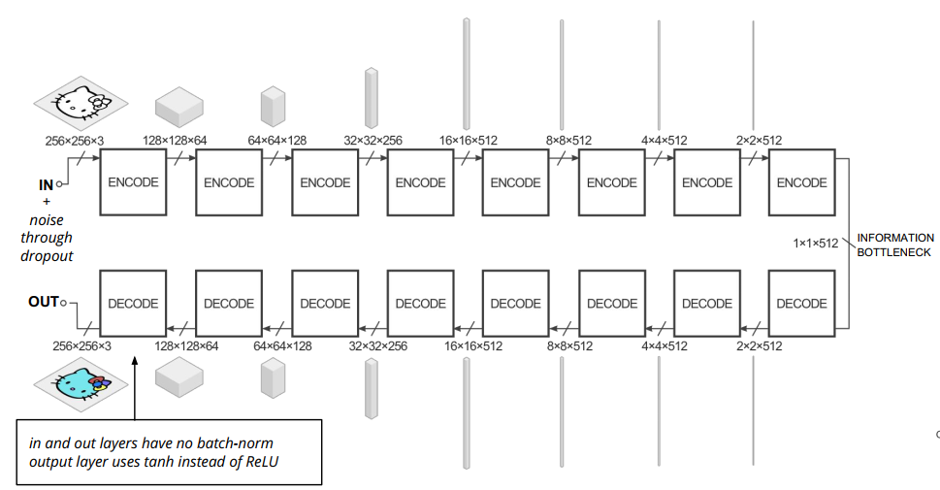
Generator Architecture: based on DCGAN
# filter size of 4×4 and a stride of 2×2
All ReLUs in the encoder are leaky, with slope 0.2, while ReLUs in the decoder are not leaky.

Slide 12
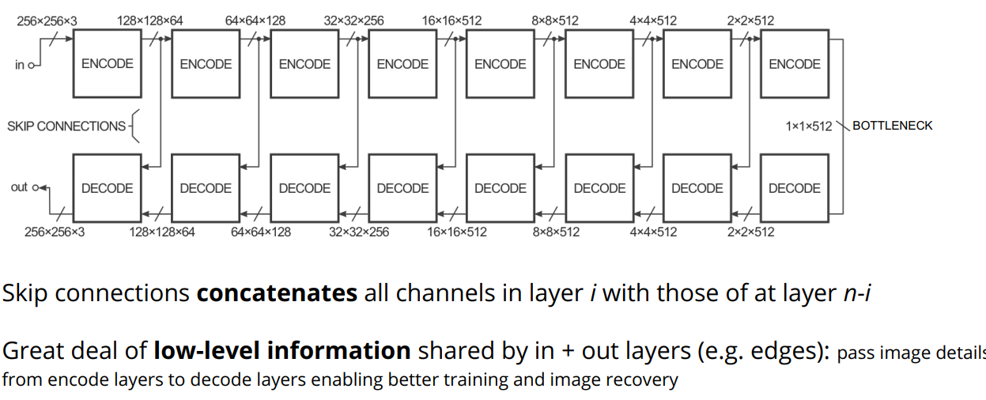
Improve Performance: U-Net

Slide 13
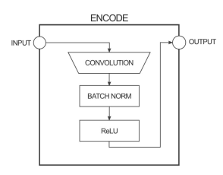
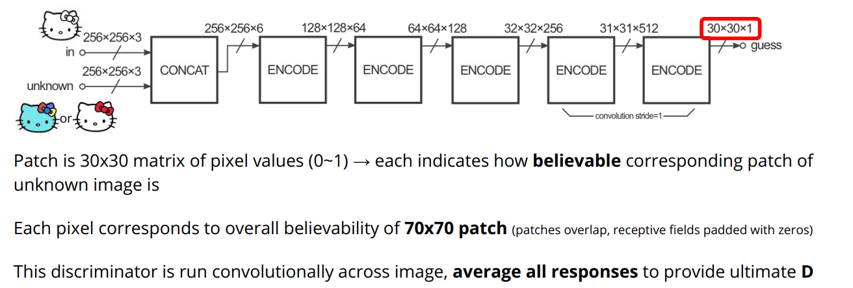
Discriminator Architecture
Discriminators used: 70*70 discriminator; 1*1 discriminator ; 16*16 discriminator; 286*286 discriminator

Slide 14
Optimization
Minibatch SGD(Stochastic gradient descent )
Applied the Adam solver (The Adam optimization algorithm is an extension to stochastic gradient descent)
Learning rate of 0:0002, and momentum parameters β1 = 0.5, β2 = 0.999

Slide 15
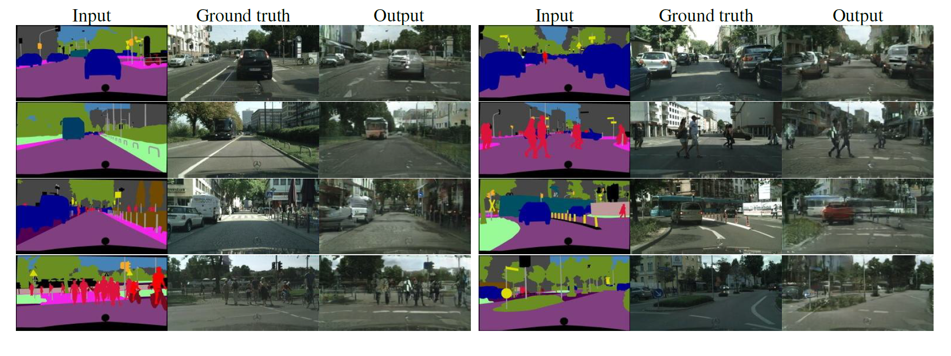
Example of Experiments
1- Semantic labels → photo (Cityscrapes dataset is used (~3000 images) )

Slide 16
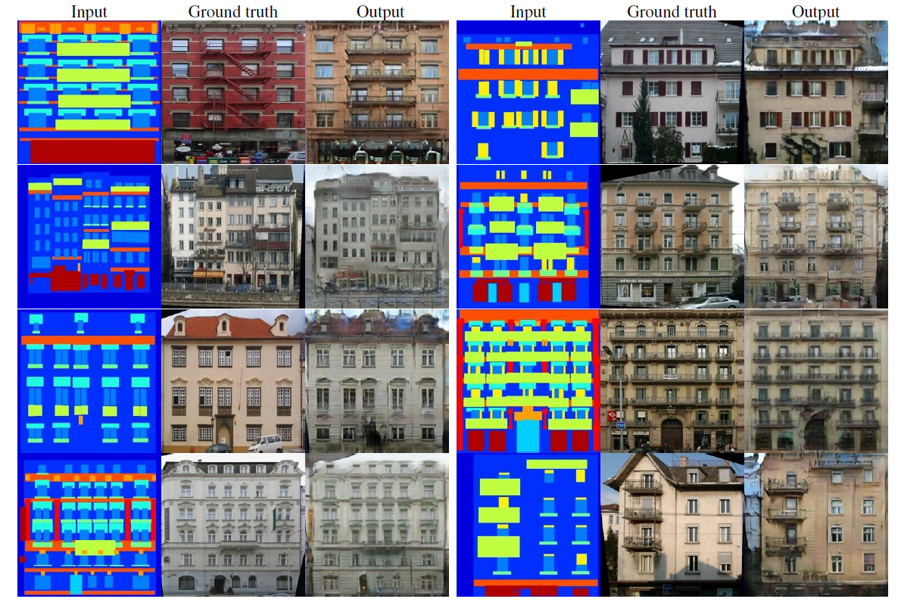
Example of Experiments
2- Architectural labels → photo (CMP Facades dataset is used (~400 images))

Slide 17
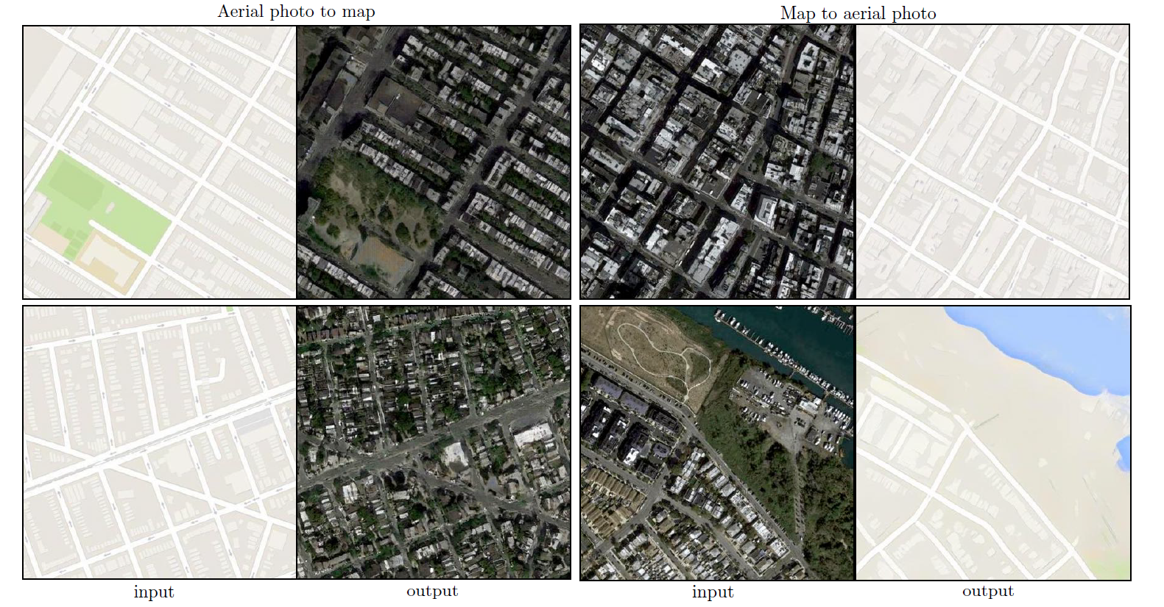
Example of Experiments
3- Aerial photo ←→ map (Data from Google Maps is used (~1100 images) )

Slide 18
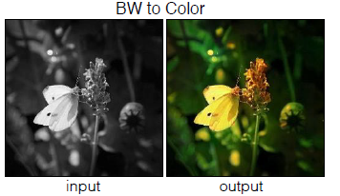
Example of Experiments
4- BW→ color photo (Imagenet dataset is used (~1.2 million images) )

Slide 19
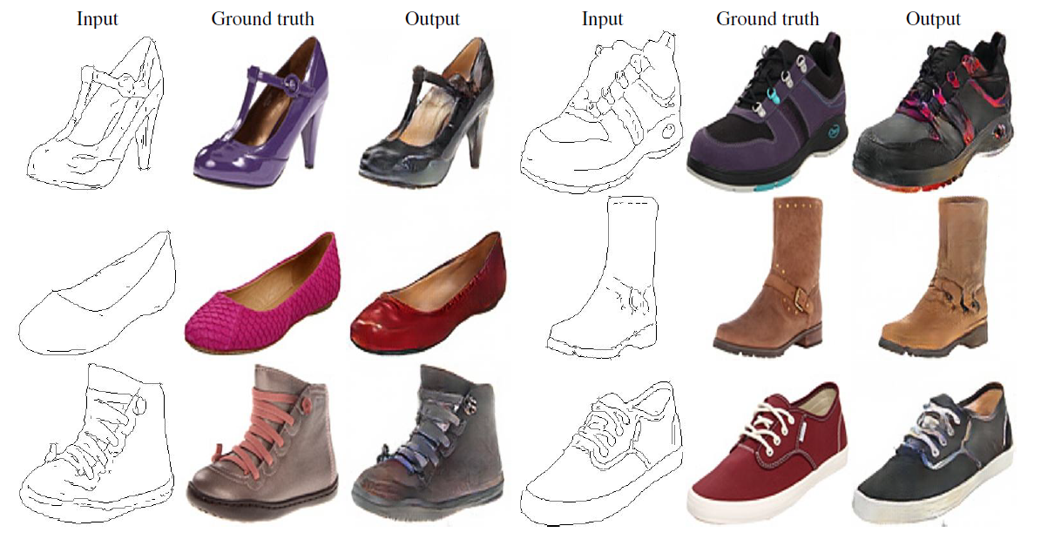
Example of Experiments
5- Edges→ photo (shoe) (UT Zappos50K dataset is used (~50K images) )

Slide 20
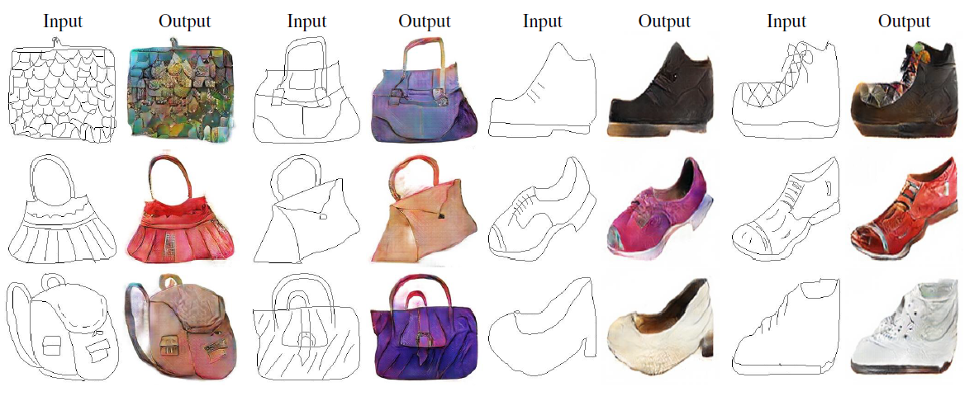
Example of Experiments
6- Sketch (edge)→ photo (human-drawn sketches are used (~137K images ) )

Slide 21
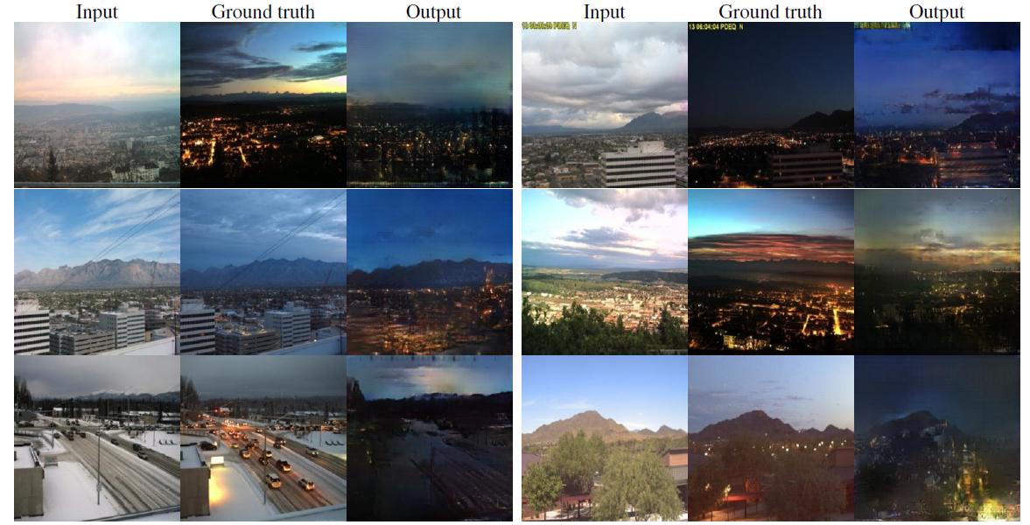
Example of Experiments
7- Day → night conversion (webcam (~100 ), images (~18000) is used

Slide 22
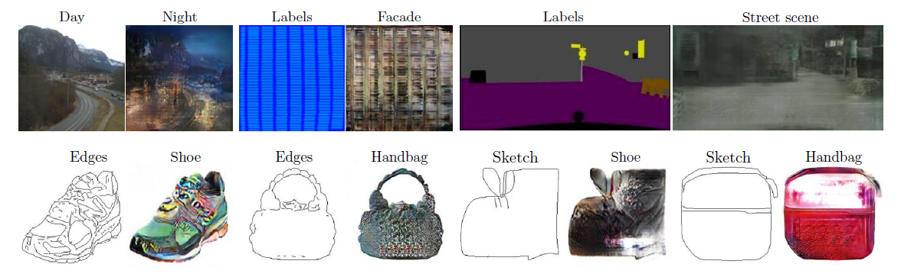
Example of failed result
Common failures
-Sparse input image
-Unusual inputs

Slide 23
Thank You.

